Slide 1




AngularJS Components
Built-in and Custom Services
SoftUni Team
Technical Trainers
Software University
http://softuni.bg

Slide 2
AngularJS Services

Slide 3

Table of Contents
What is a AngularJS Service?
Why Should You Use Services?
Built-In Services
Creating Custom Services

Slide 4

What is AngularJS Service?
Reusable Components Holding App Logic

Slide 5

What is AngularJS Service?
A worker object that performs some sort of logic
Not necessarily over-the-wire
Often stateless
Lazily instantiated
Singletons
Built-in services always start with $
E.g. $http, $location, $log, $q, $animate, …

Slide 6
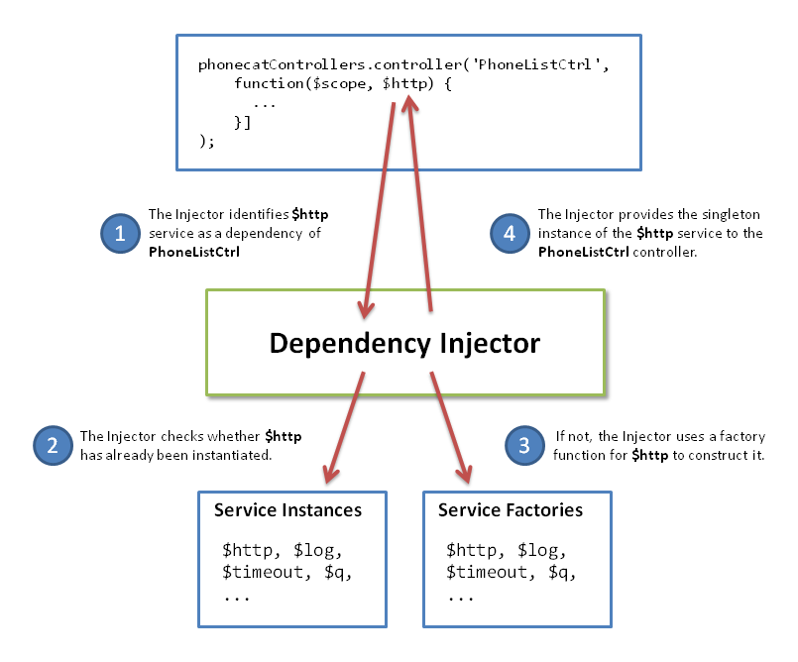
Why Use Services?
Reusability
Services encapsulate reusable business logic
Dependency Injection
Inject services into controllers / other services
Single Responsibility Principle
Better encapsulation
Testable

Slide 7


Built-In Angular Services
$http, $resource, $location, $q, …

Slide 8
Built-In Angular Services
$http – communication with remote servers via HTTP
$resource – RESTfull server-side data sources interaction
$location – navigation between pages in the app
$route / $routeParams – map URL to routes
$q – promise library for asynchronous execution
$exceptionHandler – handles uncaught exceptions
$anchorScroll – scrolls to the related element

Slide 9
Built-In Angular Services (2)
$cacheFactory – cache functionality
$compile – compiles an HTML string or DOM
$parse – converts AngularJS expression into a function
$locale – localization rules for various Angular components
$timeout – timeout with compiling (like setTimeout)
$filter – formatting data displayed to the user
$cookieStore – cookies wrapper

Slide 10
Other Built-In Angular Services
$interpolate
$log
$rootScope
$window
$document
$rootElement
$httpBackend
$controller

Slide 11
Built-In Angular Services
Live Demo

Slide 12

Creating Custom Services
Defining Reusable Services in Angular

Slide 13
Creating Custom Angular Service
myApp.factory('data', function data() {
return {
getVideos: getAllVideos,
addVideo: addVideo,
}
});
myApp.controller('VideosController',
function VideosController($scope, data) {
data.getVideos();
});

Slide 14
Creating Custom Services
Live Demo

Slide 15


Summary
Which would be the best way to access a RESTFul web service?
Using $resource service
Which service would you use to localize date-time?
$locale
Can child scopes access items on the root scope?
Yes, due to prototypal inheritance
SPA with AngularJS

Slide 16
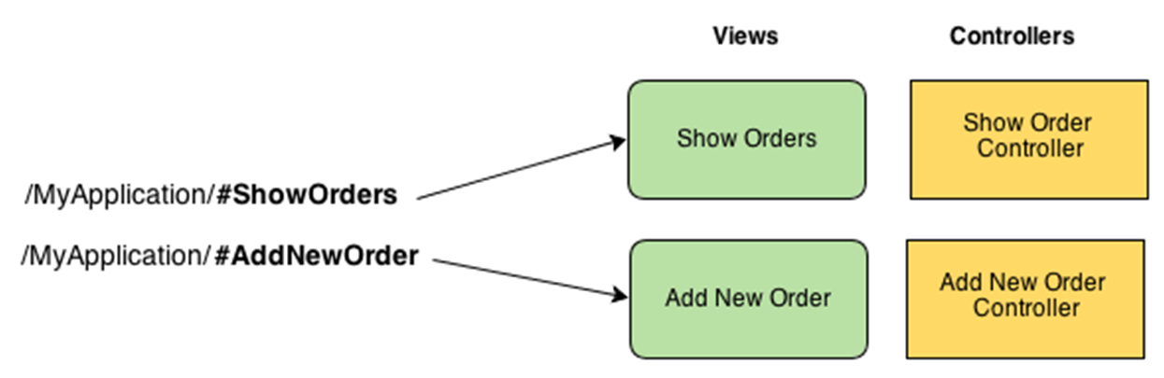
AngularJS Routing
Routes, Route Parameters, Templates, Location, Navigation

Slide 17
Table of Contents
What is Routing in SPA?
What is Template?
Create and Navigate Routes
Working with Route Parameters
Enabling HTML5 Routing
Inspect URL Parts

Slide 18

What are Routing and Templates?
Routes and Templates in SPA

Slide 19
What is Routing in SPA?
Routing in SPA == mapping certain URL to certain page
E.g. #/user/orders → shows user's orders, #/login → shows the app login form
Provides history ([Back] and [Forward] browser buttons)
Descriptive URLs for the end user
Routing in Angular maps application paths to certain controllers + partial views (templates)

Slide 20
What is Template?
Templates == HTML fragments stored as .html files
E.g. a HTML template for listing customer orders in a table
Contain part of the web page (a partial view)
Usually bound to data stored in the $scope
Usually are rendered through AJAX
Rendered somewhere in the DOM
Typically in the <div ng-view /> element

Slide 21
Creating Routes in AngularJS
Routes, Templates and Controllers

Slide 22
Creating Routes in Angular
Create default page for your module (e.g. index.html)
Include all scripts (e.g. angular.js, angular-route.js, …)
Create <ng-view> directive inside your default page
Create a template (e.g. templates/news.html)
<header>
<a href="#/">Home</a>
<a href="#/news">News</a>
</header>
<ng-view>
// Here partial views will be rendered
</ng-view>

Slide 23
Creating Routes in Angular (2)
Include angular-route.js module
Add ngRoute dependency for your module
Add config and use $routeProvider to define your routes
var app = angular.module('app', ['ngRoute'])
.config(function($routeProvider) {
$routeProvider.when('/news', {
templateUrl: 'templates/news.html',
controller: 'NewsController'
});
$routeProvider.otherwise({ redirectTo: '/' });
});

Slide 24
Creating Routes in Angular
Live Demo

Slide 25
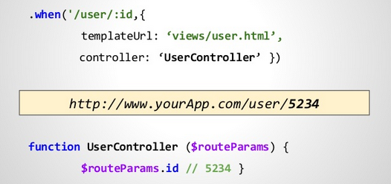
Working with Route Parameters

Slide 26
Working with Route Parameters
Pass news id as URL parameter
Add route for the page
Read the parameters through the $routeParams service
http://localhost:8080/#/news/4
$routeProvider.when('#/news/:newsId', {
templateUrl: 'templates/news-details.html',
controller: 'NewsDetailsController'
});
app.controller('NewsDetailsController', function($scope, $routeParams, newsData) {
$scope.news = newsData.getNewsById($routeParams.newsId);
});

Slide 27
Working with Route Parameters
Live Demo

Slide 28
Using the $route Service
URL:
params can access all parameters
pathParams only includes the parameters that are part of the route
reload reloads the page without reloading the entire application
http://localhost:8080/news/2?page=12
$route.current.params.newsId; // 2
$route.current.params.page; // 12
$route.current.pathParams.newsId; // 2
$route.current.pathParams.page; // undefined
$route.reload();

Slide 29
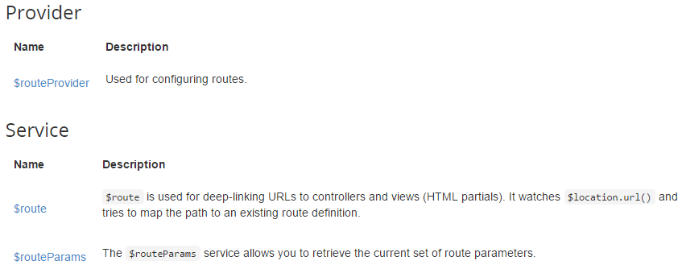
Using the $route Service
Live Demo

Slide 30
Enable HTML5 Routing
Inject $locationProvider in config function
Enable HTML5 Routing
Remove hashes (e.g. #) from menu links
You have HTML5 Routing
$locationProvider.html5Mode(true);
<a href="#/news">News</a>
<a href="news">News</a>
http://localhost:8080/news
http://localhost:8080/news/1

Slide 31
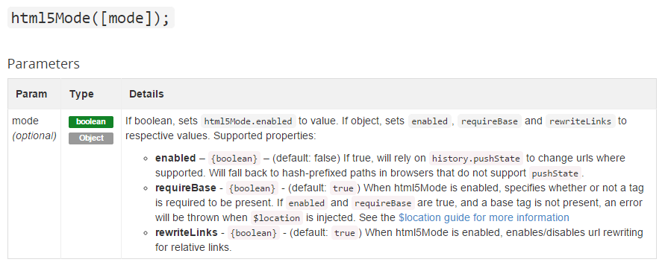
Enable HTML5 Routing
Live Demo

Slide 32
Inspecting URL Parts with $location
Using the $location service:
absUrl() → http://localhost:8080/news
protocol() → http
port() → 8080
host() → localhost
path() → /news
url() → /news
http://localhost:8080/news

Slide 33
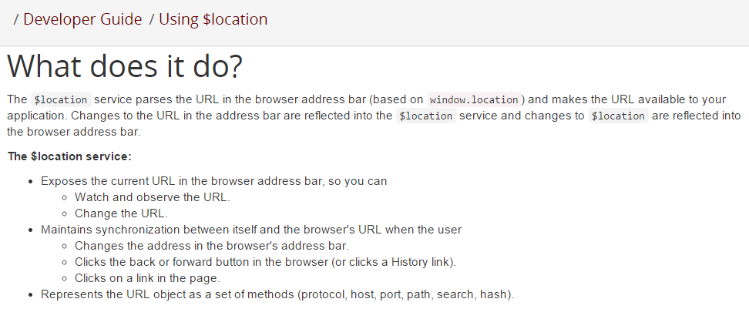
Using $location Service
Live Demo

Slide 34
Summary
Which service do you use to create routes?
$routeProvider
Which service do you use to access the route parameters?
$routeParams
How do you enable HTML5 routing?
$locationProvider.html5Mode(true);
SPA with AngularJS

Slide 35

AngularJS Directives
Defining Custom Directives

Slide 36

Table of Contents
What is Directive?
Uses for Directives
Creating Directives
Isolating Directive Scope
Handling Events with Directives
Using Controllers with Directives
Using jQuery in Directives

Slide 37
What is a Directive in Angular?

Slide 38
What is a Directive?
Directives == markers on a DOM element
Attribute / element name / CSS class / comment
E.g. ng-view, ng-model, ng-bind, ng-class, …
Extends the standard HTML behaviour
Can define domain-specific tags (e.g. <order></order>)
Easier to read the HTML code
Cross-browser "web components" functionality

Slide 39
Uses of Directives
Custom elements
E.g. <div ad-box>…</div>
Custom events
E.g. define onclear event
Observe and react to changes
E.g. make and uppercase-only input field

Slide 40
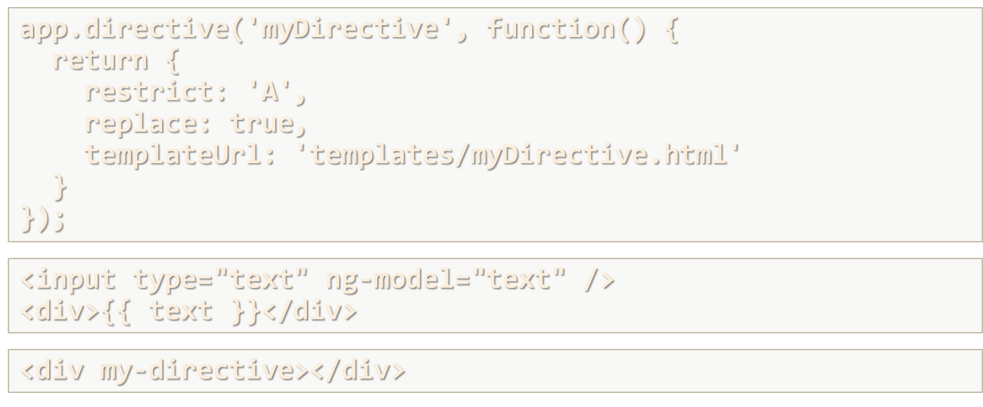
Defining Directives in Angular

Slide 41
Creating Directives
Directive
app.directive('myDirective', function() {
return {
restrict: 'A',
replace: true,
templateUrl: 'templates/myDirective.html'
}
});
'E‘: Element,
'A‘: Attribute,
'C‘: Class,
'M‘: Comment
Replace element with the template
Template
<input type="text" ng-model="text" />
<div>{{ text }}</div>
HTML
<div my-directive></div>

Slide 42
Defining Directives in Angular
Live Demo

Slide 43
Isolating Directive Scope
We can only use directive once within a given scope
Directives use parent scope
We can create new scope (isolated scope)
app.directive('adBox', function () {
return {
templateUrl: '/templates/directives/adBox.html',
scope: { ad: "=" }
}});
Isolated scope: '&', '@', '='
<div ad-box ad=ad></div>

Slide 44
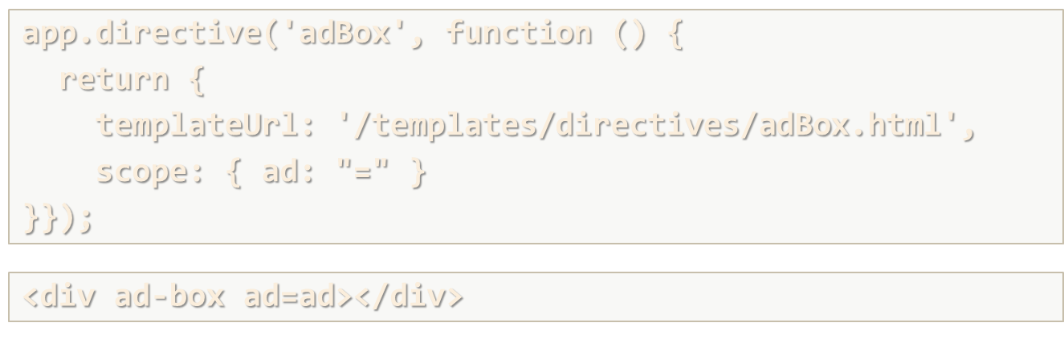
Isolation Directive Scope
Live Demo

Slide 45
Using Controllers with Directives
app.directive('myDirective', function () {
return {
template: '<button ng-click="showAlert()">Show alert</button>',
controller: 'MyController'
}});
app.controller('MyController', function ($scope) {
$scope.showAlert = function() {
alert('Hello SoftUni Friends!');
}
});

Slide 46
Handling Events with Directives
<input type="text" validate-symbols />
app.directive('validateSymbols', function() {
return {
restrict: 'A',
link: function(scope, element, attrs, controller) {
element.on('keydown', function(event) {
if(event.keyCode >= 97 && event.keyCode <= 122) {
return true;
}
return false;
})
}}});
You can type only lowercase English letters

Slide 47
Using jQuery in Directives
<input type="text" date-picker />
app.directive('datePicker', function() {
return {
restrict: 'A',
link: function(scope, element) {
element.datepicker();
}
}
});
Add datepicker to the current element

Slide 48

Summary
How you can restrict directive to be used as element?
restrict: 'E'
What are the two ways to specify the HTML used by your directive?
template and templateUrl
How would you handle an element event with directive?
link function with element.on('eventName', …)
SPA with AngularJS

Slide 49









AngularJS Components
https://softuni.bg/courses/spa-applications-angularjs

Slide 50
License
This course (slides, examples, demos, videos, homework, etc.) is licensed under the "Creative Commons Attribution-NonCommercial-ShareAlike 4.0 International" license
Attribution: this work may contain portions from
"SPA with AngularJS" course by Telerik Academy under CC-BY-NC-SA license

Slide 51





Free Trainings @ Software University
Software University Foundation – softuni.org
Software University – High-Quality Education, Profession and Job for Software Developers
softuni.bg
Software University @ Facebook
facebook.com/SoftwareUniversity
Software University @ YouTube
youtube.com/SoftwareUniversity
Software University Forums – forum.softuni.bg

